Slide 1
Options Presentation
Class of 2026

Slide 2
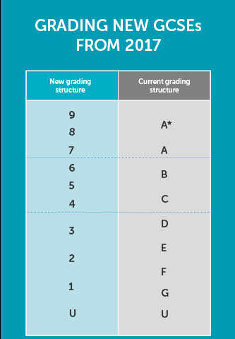

Slide 3
Options 2024
First step in preparation for life after St Anne’s RC Voluntary Academy
Move on to the courses, training and careers that will enable you to realise your dreams
Ensure that you enjoy your time with us and achieve the best results you can

Slide 4
Core Subjects
English Language
English Literature
Mathematics
Science (Double Award)
Religion
PSHE
PE (core)

Slide 5
Option Subjects
Other GCSE’s
Art and Design
Business Studies
Drama
Food Preparation and Nutrition
Music
Physical Education
BTEC
Health and Social Care
Construction
Ebacc GCSE’s
History
Geography
Spanish
Triple Science
Computer Science

Slide 6
GCSE – General Certificate of Secondary Education. These are available in the ‘traditional’ subjects. GCSEs are now graded on a 1-9 scale, with 9 being the highest grade. A standard pass is a grade 4 whilst a strong pass is considered to be a grade 5. There are always exams in GCSE subjects at the end of the two year course.
BTEC— These vocational qualifications are designed to complement GCSE’s. Students work through themed units exploring an industry sector. They apply learning through scenario based tasks and tests. BTEC’s can be used as a progression route to further study, to an apprenticeship or into employment. The qualifications are graded from level 1 to level 2; level 1 is comparable to GCSE grades 1-3 and level 2 GCSE grades 4-9.

Slide 7
English Baccalaureate (Ebacc)
Although not a qualification in itself, is a measure of success in core academic subjects; specifically English, maths, history or geography, the sciences and a language
Subjects most likely to be required or preferred for entry to degree courses and ones that will keep the most doors open

Slide 8
Ebacc Route
Core subjects
Language- Spanish
Humanities- Geography or History
Any other qualification

Slide 9
KS4 Structure (per fortnight)
English – 9 lessons
Maths – 8 lessons
Science – 10 lessons
Religious Studies – 5 lessons
Physical Education – 2 lessons
PSHE – 1 lesson
Option A – 5 lessons
Option B – 5 lessons
Option C – 5 lessons
TOTAL – 50 lessons

Slide 10
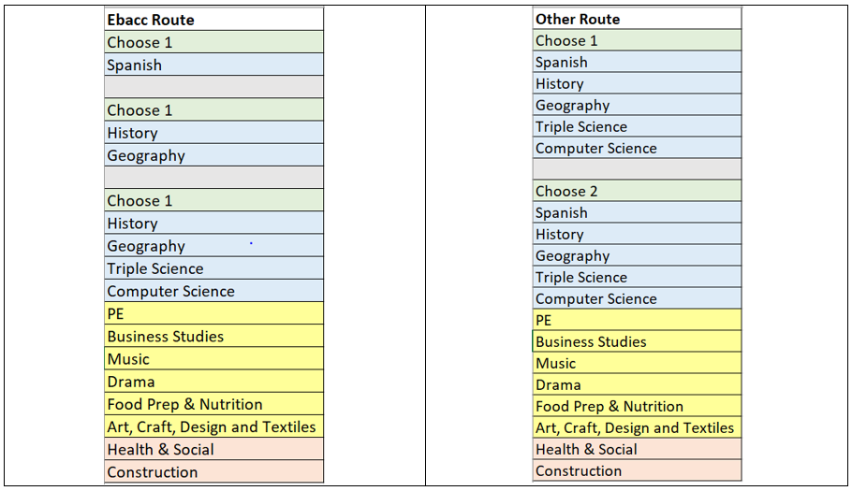

Slide 11
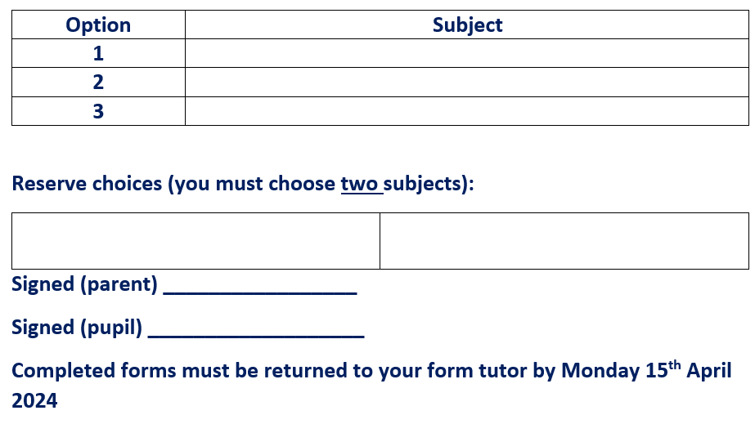

Slide 12
The deadline for option forms to be submitted is Monday 15th April 2024
You’ll be studying the subjects you choose for the next two years and the choices you make now can also affect your future direction.
Mr Donnelly, Head of Year, is available for advice as is your form tutor and Miss Morgan our SENDCO.
Mrs Worsley our Careers Advisor in school is also available to answer careers questions.

Slide 13
It is worth looking ahead, as decisions you make now may narrow your choices later.
University courses have set entry requirements and may require certain subjects at A-level. In the same way, you many need a GCSE in a subject to study it at A-level. Check carefully as this is not always the case and you can start some subjects from scratch at A-level and university.
Trades and professions also have recognised routes to qualifying, so it may help to work backwards when deciding what to do next.
While your working life may seem years away, giving some thought to your career ideas now can make a real difference to your future.

Slide 14
Next Steps
Options form all in Monday 15th April
If appropriate; student interviews regarding choices- Half Term 5
Students/parents will be informed of qualification offer June 24

